Slide 1

Zomato Analytics Dashboard
Name: Sudhanshu Vilas Kulkarni
Guided by: Newton School

Slide 2
Problem Statement
You are hired as a consultant data analyst by Zomato where the team is looking for expansion and opening more restaurants. Your task is to develop strategies/suggestions for opening newer restaurants.

Slide 3
Introduction
This dashboard provides an analytical view of restaurant performance data across multiple countries using Zomato’s dataset.
The goal is to analyze the data and predict which region or at what price should one open a restaurant.
Data is analyzed with various attributes such as year, price, cuisines, ratings etc.

Slide 4
Steps Taken
01
02
Data Cleaning
Data Collection
04
05
Visualisation
Slicers
03
Data Transformation
Gathered data in an e.xcel sheet
Removed duplicates and irrelevant data to ensure accuracy.
Extracted the year from date column and used VLOOKUP to extract country name through country code.
Created charts according to requirements
Added Slicers to look over a particular data.

Slide 5
Data Overview
Dataset is first overlooked and analyzed.
It contains columns such as City, Country, Restaurant Name, Year, Date of opening, votes, rating, price range etc.
Rating: It tells the overall rating of a restaurant
Year: It tells when the restaurant was built
Votes: It tells how many people have voted for that particular restaurant

Slide 6
Approaching the Dataset
Checked the dataset for any null values and removed them from the dataset.
Looked for the duplicate values and processed them accordingly.
Added three columns Year, Rating Roundup and Country.
Added the country column using VLOOKUP function with the help of country code table.
Added the Year column using the LEFT function.
Added the Rating Roundup column using conditional aggregation.

Slide 7
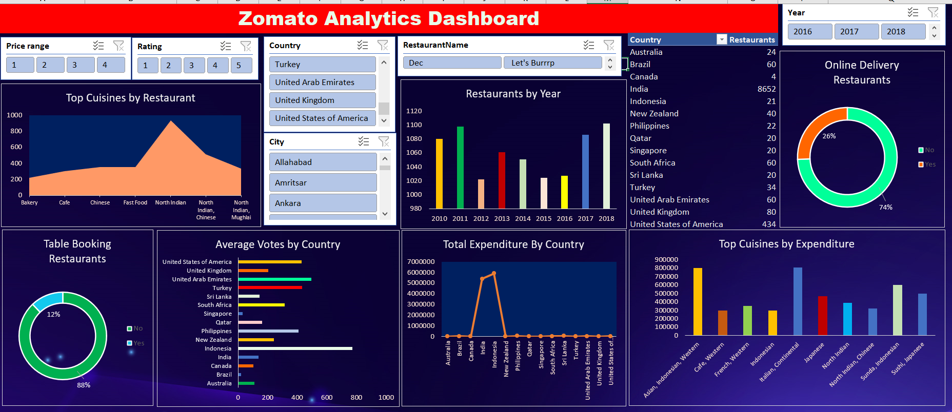
The Dashboard

Slide 8
Dashboard Overview
Donut Chart
Bar Chart
Column Chart
Pivot Table
Slicer
Arial and Line Chart
Two Clusterd column charts to show Restaurants buit by years and Expenditure on the basis of Cuisines
Two Donut Charts which show percentage of Online booking and table booking
A Bar Chart for showing Average number of voters by country
Eight pivot tables for creating charts and adding slicers
Six slicers to show Price range, Ratings, Country, City, Restaurant name and Year
One Arial and Line chart for showing top Cuisines by country and Expenditure by Country.

Slide 9


Uses of Zomato Analytics Dashboard
Check Restaurant Performance: It helps you see how well restaurants are doing in different countries or cities based on customer ratings, votes, and the average cost for meals.
Find New Business Opportunities: The dashboard shows areas where there aren’t many restaurants, helping you find good spots to open new ones.
Follow Food Trends: You can track what types of food are popular in different places, so you can offer what people love to eat in those areas.
Make Better Business Decisions: It gives you data on customer preferences and trends, helping you decide where to open new restaurants or what changes to make in existing ones.
Understand Pricing in Different Areas: The dashboard shows how much people typically spend on meals in different cities, helping you set prices that fit the local economy.

Slide 10
Summary
The Zomato analytics dashboard provides a comprehensive view of restaurant performance across different countries, cities, and regions.
It allows users to track key metrics like customer ratings, votes, average cost for meals, and availability of services such as table booking and online delivery.
The dashboard is designed to help restaurant owners and decision-makers identify new opportunities for growth by highlighting underrepresented areas, popular cuisine trends, and pricing strategies based on local spending habits.
It serves as a valuable tool for optimizing business strategies, improving services, and making informed decisions about where and how to expand restaurant operations.

Slide 11
Conclusion
The Zomato analytics dashboard is a powerful tool for gaining valuable insights into the restaurant industry. By providing a clear view of performance metrics, customer preferences, and market trends.
It empowers restaurant owners and stakeholders to make data-driven decisions. Whether identifying new locations for expansion, understanding local dining habits, or improving service offerings.
The dashboard offers the necessary information to optimize operations and seize growth opportunities.
Ultimately, it helps businesses stay competitive in the dynamic food industry and meet the evolving needs of their customers.

Slide 12
THANKYOU

